Slide 1
AZURE AI FUNDAMENTALS

Slide 2
About Presenter
Name: Abdul Khadar
Designation: DevOps Engineer
Team: Cloud CoE
Expertise: Azure, DevOps, AWS

Slide 3

Contents
What is AI ?
Overview of Azure AI services
Artificial Intelligence – All around you
Vision related APIs
Understanding types of AI
Natural Language Processing
Impact of AI
Decision Service
Three Approaches to Build AI Solutions in Azure
What is Generative AI ?
Pre-trained models(APIs)

Slide 4
Contents
Challenges in Building AI Solutions
Machine Learning
Machine Learning Terminology
Responsible AI Principles
Creating ML Models – features and labels
Useful Links
Types of Machine Learning
AI-900
Azure Machine Learning

Slide 5
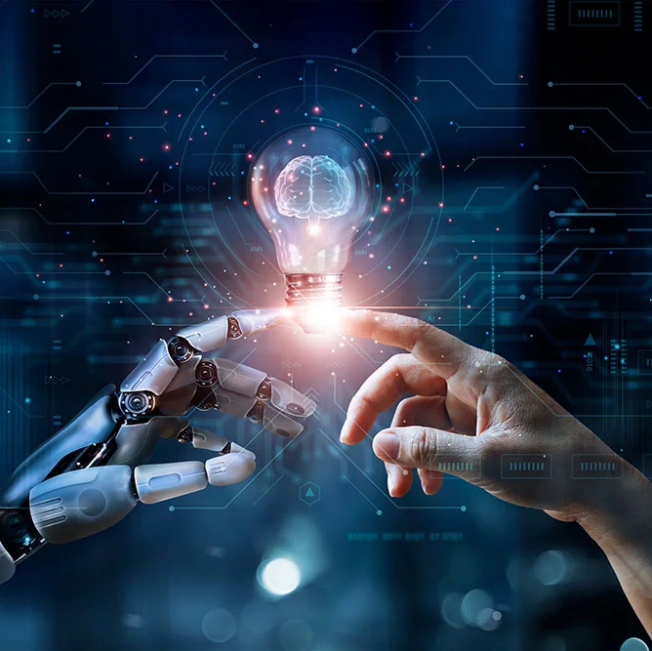
What is AI ?
Oxford dictionary definition:
The theory and development of computer systems able to perform tasks normally requiring human intelligence, such as visual perception, speech recognition, decision making, and translation between language
Artificial intelligence is the science of making machines that can think like humans. It can do things that are considered “smart”. AI technology can process large amounts of data in ways, unlike humans. The goal for AI is to be able to do things such as recognize patterns, make decisions, and judge like humans.

Slide 6
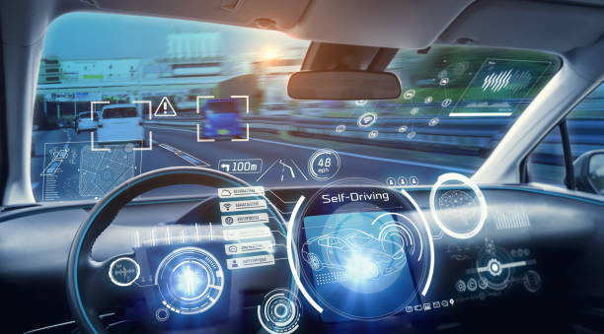
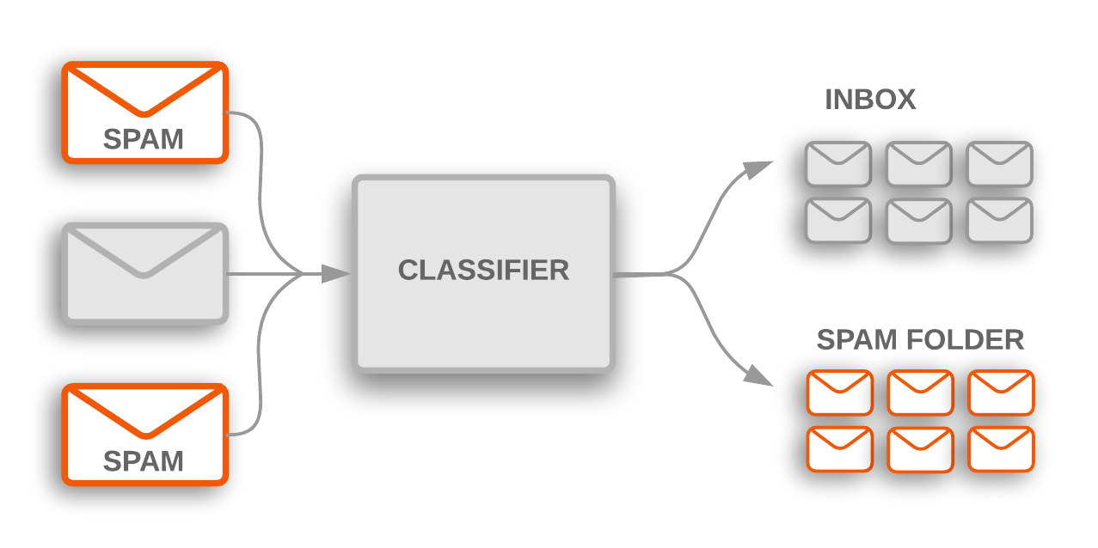


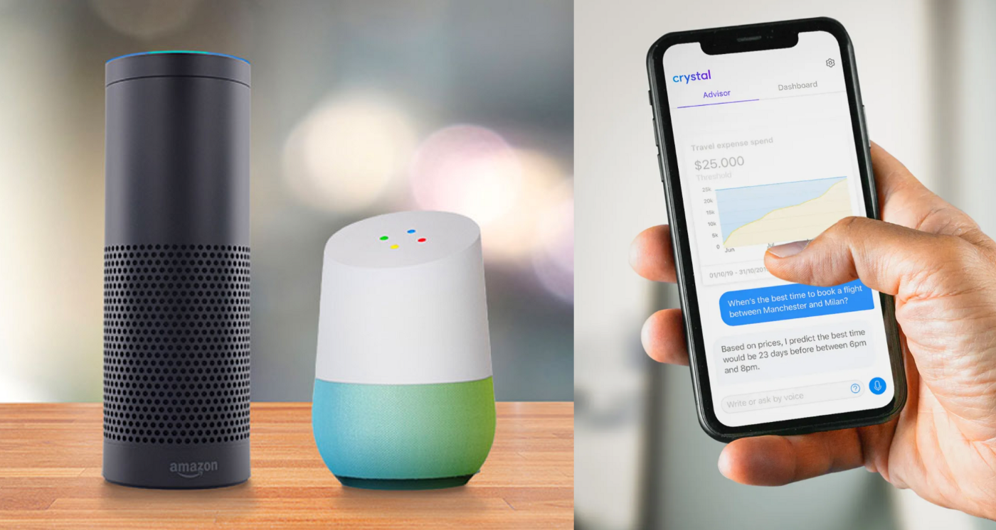
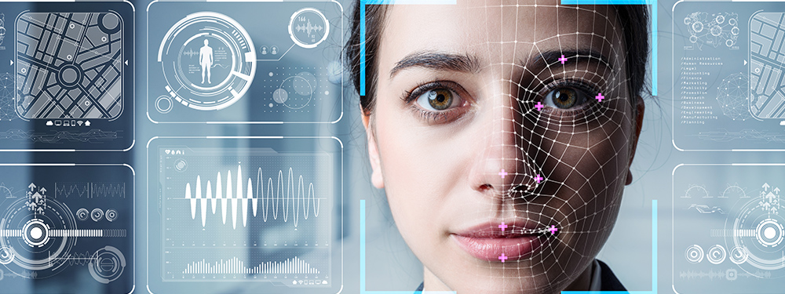


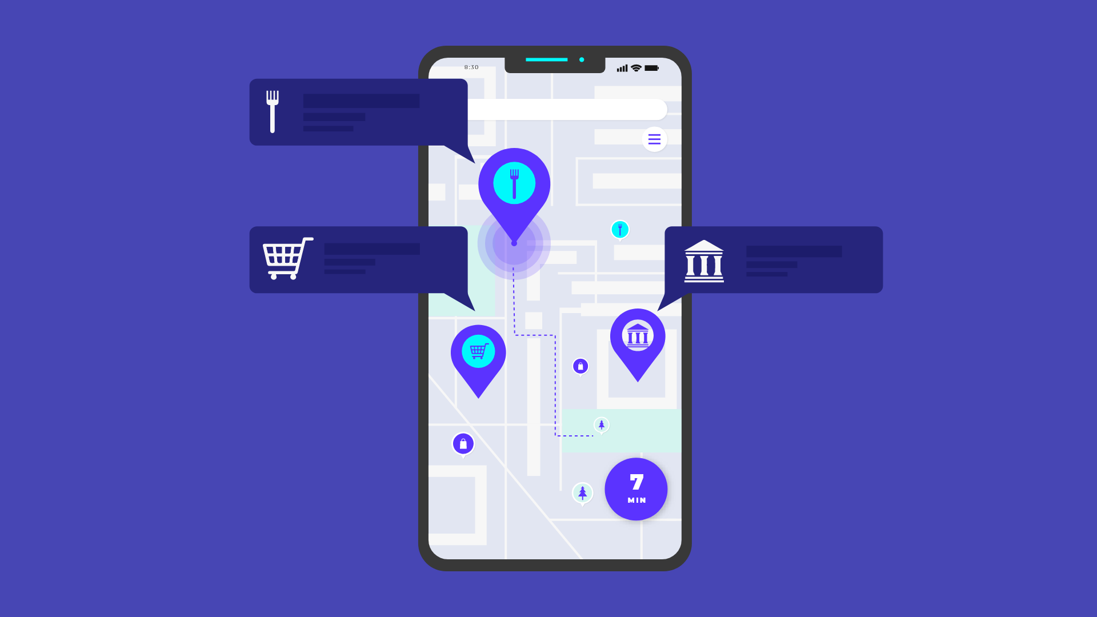

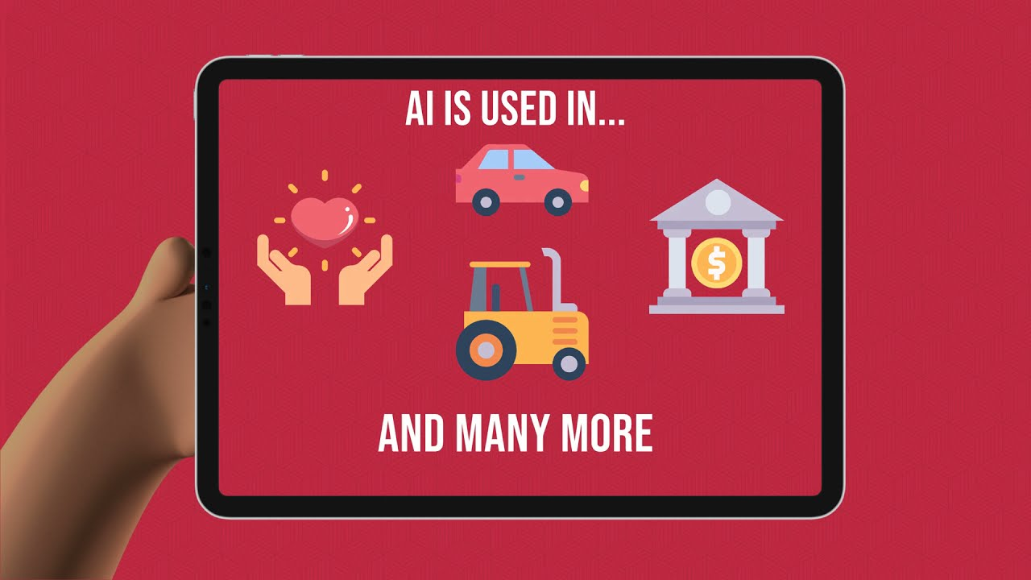
Artificial Intelligence – All around you
Self-driving cars
Health care
Email Classification
Banking
Fraud Detection
Video games
Social media
Navigation
Smart homes
Customer service
Facial recognition
And many more….

Slide 7
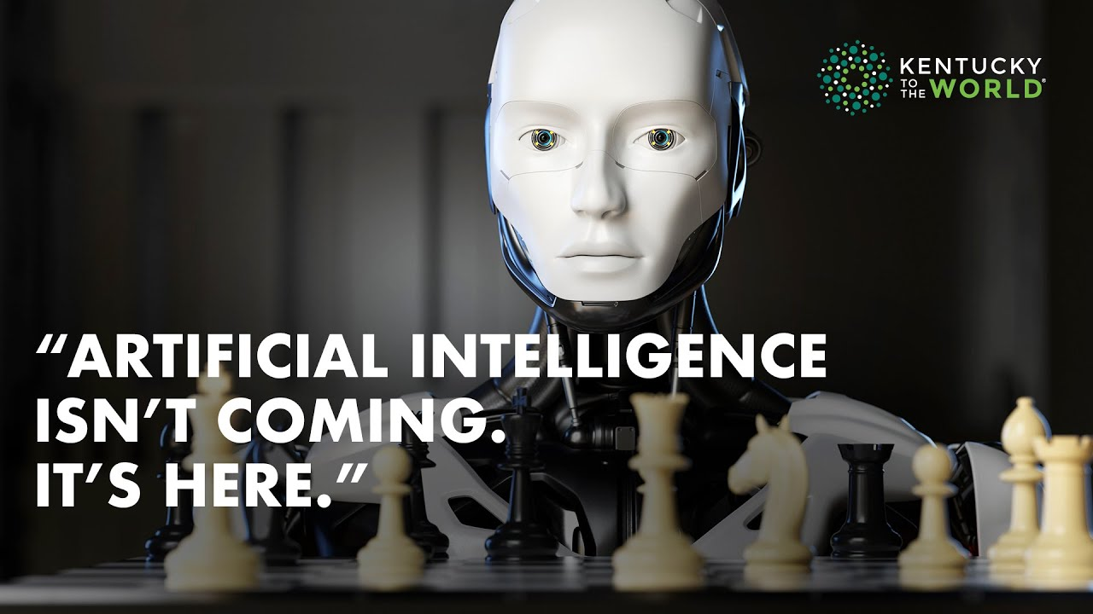
Understanding types of AI
Strong artificial intelligence (or general AI):
Intelligence of machine = Intelligence of human
A machine that can solve problems, learn, and plan for the future
An expert at everything, learns like a child, building on its own experiences
We are far away from achieving this!
Narrow AI (or weak AI):
Focuses on specific task
Examples: Self-driving cars and virtual assistants
Machine Learning
Learn from data (examples)

Slide 8
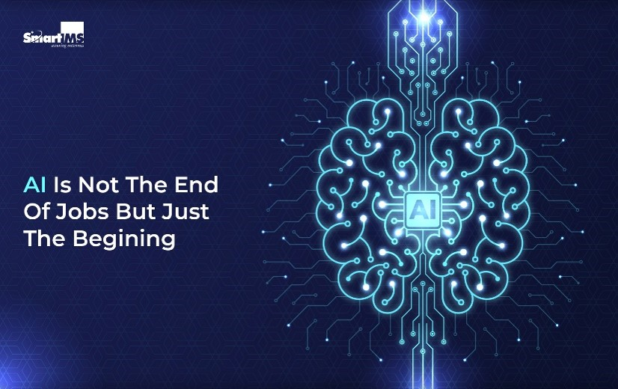
Impact of AI
The future of AI in 2050 is uncertain, but it can be more advanced and integrated into our daily lives
Ethical concerns and regulations will also play a crucial role in shaping the future of AI
Several areas within IT are and will continue to be influenced by AI advancements: Automation and Optimization, Cybersecurity, Predictive Analytics, Natural Language Processing (NLP), Big Data Management and Analysis, Cloud Computing, Software Development and Testing, IT Service Management (ITSM), Robotics and Autonomous Systems

Slide 9
Three Approaches to Build AI Solutions in Azure
Use Pre-Trained Models
Azure AI Services
Get intelligence from text, images, audio, video
Build simple models
Without needing data scientists
Limited/no-code experience
Example: Custom Vision, Automated machine learning
Build complex models
Using data scientists and team
Build Your Own ML Models from ZERO (code-experienced)
Example: Using Azure Machine Learning

Slide 10
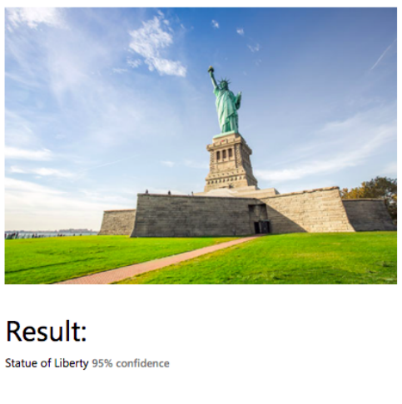
Pre-trained Models (APIs)
Azure AI Services - "bring AI within reach of every developer“
AI without building custom models
Does NOT need machine-learning expertise, Exposed as APIs
Help programs see, hear, speak, search, understand just like humans
Get intelligence from:
Images/videos: Computer vision, Face API, Form Recognizer
Text: Text Analytics, Translator Text, Text-to-Speech API
Audio: Speech-to-Text API, Conversational Language Understanding – CLU
Conversations: Question Answering, Azure Bot Service
Decision: Anomaly Detector, Content moderator

Slide 11
Overview of Azure AI Services
Azure AI
Vision related APIs
Natural Language Processing
Decision service
Machine Learning
Computer vision
Language
Anomaly detector
Automated machine learning
Text analytics
Content moderator
Face API
Azure ML designer
Translator
Speech
Data & compute management
Custom vision
Conversational AI
Question Answering
Pipelines
Form recognizer API
CLU
Bot service

Slide 12
Vision related APIs
Vision: Get intelligence from images & videos
Identify and analyze content within images & video
You can use Microsoft's Azure AI Vision Studio to
develop computer vision solutions
Important APIs:
1. Computer Vision: Analyze content in images and videos
2. Face API: Detect and identify people and emotions in images
3. Custom Vision: Customize image recognition to fit your business
4. Form Recognizer API: Extract information from scanned forms

Slide 13
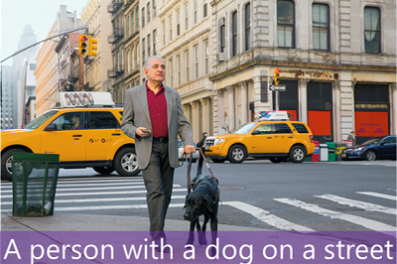
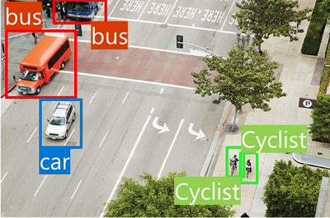
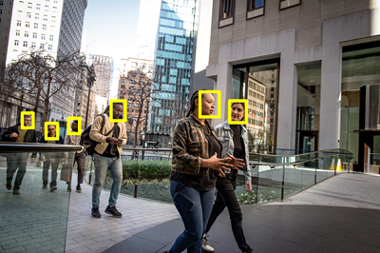


Vision - Terminology
Image analysis: Extract tags from image, Create text description about an image
Image classification: Classify image into different groups
Object detection: Identify objects in image
For each object: class of object, confidence level, coordinates of a bounding box
Goes deeper than image classification
Face detection: Detect human faces, Used for security, Tag friends on Facebook, Identity validation
Optical character recognition (OCR): Detect text in images (license plates, invoices etc.)
Image analysis: Extract tags from image, Create text description about an image
Image classification: Classify image into different groups
Object detection: Identify objects in image
For each object: class of object, confidence level, coordinates of a bounding box
Goes deeper than image classification
Face detection: Detect human faces, Used for security, Tag friends on Facebook, Identity validation
Optical character recognition (OCR): Detect text in images (license plates, invoices etc.)

Slide 14
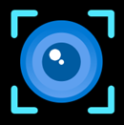
1. Computer Vision
Computer Vision API: Process images and return information
Analyze Image: Extract visual features from image content
Describe Image: Generates description of the image or caption the image
Detect Objects: Performs object detection on the specified image
Recognize Domain Specific Content: Identify celebrities, landmarks
Tag Image: Generates a list of words, or tags relevant to a image
Get Area of Interest: most important area of the image
OCR: detects text in an image and extracts the recognized words into a machine-readable character stream

Slide 15
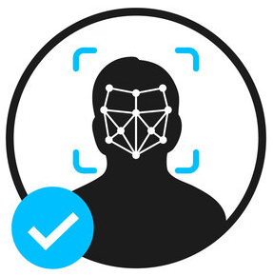
2. Face API
Face API is used to detect Age, Emotion, Glasses, Hair, Makeup
Its main operations are to detect human faces, find similar faces, match face with a group
To improve accuracy of face identification:
Provide high quality of image(frontal, clear, and face size - 200x200 pixels or bigger)
Provide variety of images(from different angles in variety of lighting setups)
The more images you provide, the more the face API is confident about detecting a specific person

Slide 16

3. Custom Vision
Create custom models using your own images
Unlike the Computer Vision service, Custom Vision allows you to specify your own
labels and train custom models to detect them.
Custom Vision functionality can be divided into two features:
Classification: Predict labels for an image
Object Detection: Returns coordinates of objects in an image
How it works:
1. You submit sets of images that have and don't have the visual characteristics you're looking for
2. Then you label the images with your own custom labels (tags) at the time of submission
3. The algorithm trains to this data and calculates its own accuracy by testing itself on the same images
4. Once you've trained your model, you can test, retrain, and eventually use it in your image recognition app to classify images or detect objects
The Custom Vision service uses a machine learning algorithm to analyze images.

Slide 17

4. Form Recognizer API
Azure Form Recognizer is now Azure AI Document Intelligence
Get intelligence from scanned forms
Extract information from forms & images
Operations:
Analyze business card, Identity documents, Invoice, Receipt, Health insurance cards
You can train custom models to classify documents and extract text, structure and fields from your forms or documents.
2 types of custom models are available:
Custom extraction model
Custom classification model

Slide 18
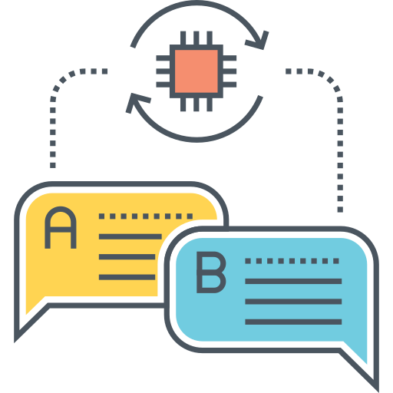
Natural Language Processing
Get intelligence from a conversation, speech or written text in human languages
NLP is an area within AI that deals with understanding written or spoken language, and responding in kind
Natural language processing might be used to create:
A social media feed analyzer that detects sentiment for a product marketing campaign.
A document search application that summarizes documents in a catalog.
An application that extracts brands and company names from text.
Azure services using NLP:
1. Language
a. Text Analytics
b. Translator
2. Speech
3. Build Conversations (Conversational AI)
a. Question Answering
b. Bot Service
4. CLU (Conversational Language Understanding)

Slide 19

1. Language
Extract meaning from unstructured text
Azure AI Language is a cloud-based service that includes features for understanding and analyzing text
It includes various features that support sentiment analysis, key phrase identification, text summarization, and conversational language understanding.
Common NLP tasks supported by language models include:
Text analysis, such as extracting key terms or identifying named entities in text.
Sentiment analysis and opinion mining to categorize text as positive or negative.
Machine translation, in which text is automatically translated from one language to another.
Summarization, in which the main points of a large body of text are summarized.
Conversational AI solutions such as bots or digital assistants in which the language model can interpret natural language input and return an appropriate response.

Slide 20
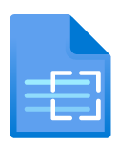
1.a. Text Analytics
Azure AI Language's text analysis features include:
Named entity recognition identifies people, places, events, and more. This feature can also be customized to extract custom categories.
Entity linking identifies known entities together with a link to Wikipedia.
Personal identifying information (PII) detection identifies personally sensitive information, including personal health information (PHI).
Language detection identifies the language of the text and returns a language code such as "en" for English.
Sentiment analysis and opinion mining identifies whether text is positive or negative.
Summarization summarizes text by identifying the most important information.
Key phrase extraction lists the main concepts from unstructured text

Slide 21

1.b. Translator
Text-to-text translation
Translator service supports the following features:
Text Translation: Execute text translation between supported source and target languages in real time
Document Translation: Translate batch and complex files while preserving the structure and format of the original documents.
Custom Translator: Build customized models to translate domain and industry-specific language, terminology, and style.

Slide 22

2. Speech
AI speech capabilities enable us to manage home and auto systems with voice instructions, get answers from computers for spoken questions, generate captions from audio, and much more.
It has two capabilities:
Speech Recognition: the ability to detect and interpret spoken input
Speech Synthesis: the ability to generate spoken output
Azure AI Speech provides speech to text and text to speech capabilities through speech recognition and synthesis
You can use prebuilt and custom Speech service models for a variety of tasks, from transcribing audio to text with high accuracy, to identifying speakers in conversations, creating custom voices, and more.

Slide 23
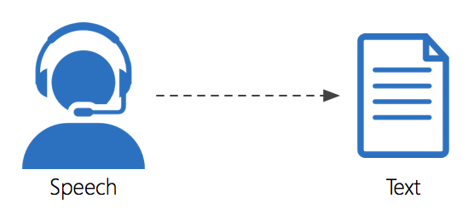
2.a. Speech to Text API
You can use Azure AI Speech to text API to perform real-time or batch transcription of audio into a text format
The audio source for transcription can be a real-time audio stream from a microphone or an audio file
Real-time speech to text allows you to transcribe text in audio streams
You can use real-time transcription for presentations, demos, or any other scenario where a person is speaking
Batch transcription can be used when you have audio recordings stored on a file share, a remote server, or even on Azure storage

Slide 24

2.a. Text to Speech API
The text to speech API enables you to convert text input to audible speech, which can either be played directly through a computer speaker or written to an audio file
When you use the text to speech API, you can specify the voice to be used to vocalize the text
The service includes multiple pre-defined voices with support for multiple languages and regional pronunciation
You can also develop custom voices and use them with the text to speech API
Both the speech to text and text to speech APIs support a variety of languages

Slide 25

3. Build Conversations (Conversational AI)
Conversational AI describes solutions that enable a dialog between an AI agent(bot) and a human
People can engage with bots through channels such as web chat interfaces, email, social media platforms, and more
Use cases: Customer support, Reservations, Automation
Services:
Question Answering: Convert your FAQ into a Q&A Bot
Azure Bot Service: Build your own bots
Recommended Architecture: Question Answering service + Azure Bot Service

Slide 26
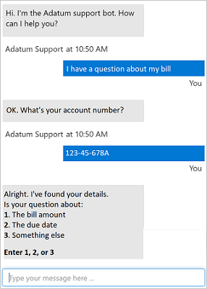
3.a. Question Answering
Question Answering is used to build bot applications that respond to customer queries
Question answering capabilities can respond immediately, answer concerns accurately, and interact with users in a natural multi-turned way
3.b. Azure Bot Service
Provides a framework for developing, publishing, and managing bots on Azure
Bots can be implemented on a range of platforms, such as a web site or a social media platform.
https://www.microsoft.com/en-us/research/project/health-bot/

Slide 27
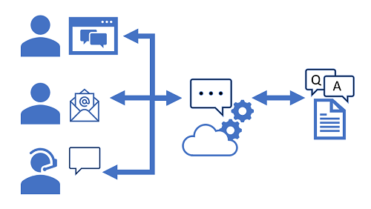
Question Answering + Bot Service
1. Creating a custom question answering knowledge base
To create a project, you must first provision a Language resource in your Azure subscription
You can use Azure AI Language Studio to create, train, publish, and manage question answering projects
2. Define questions and answers
use the Language Studio's custom question answering feature to create a project that consists of question-and-answer pairs
These questions and answers can be generated from an existing FAQ document or web page or entered and edited manually
3. Test the project
After creating a set of question-and-answer pairs, you must save it
This process analyzes your literal questions and answers and applies a built-in natural language processing model to match appropriate answers to questions
Then you can use the built-in test interface in the Language Studio to test your knowledge base by submitting questions and reviewing the answers that are returned

Slide 28
Question Answering + Bot Service
4. Build a bot with Azure AI Bot Service
After you've created and deployed a knowledge base, you can deliver it to users through a bot
You can create a custom bot by using the Microsoft Bot Framework SDK to write code that controls conversation flow and integrates with your knowledge base
However, an easier approach is to use the automatic bot creation functionality, which enables you to create a bot for your deployed knowledge base and publish it as an Azure AI Bot Service application with just a few clicks
5. Connect channels
When your bot is ready to be delivered to users, you can connect it to multiple channels; making it possible for users to interact with it through web chat, email, Microsoft Teams, and other common communication media
Users can submit questions to the bot through any of its channels, and receive an appropriate answer from the knowledge base on which the bot is based

Slide 29
4. CLU (Conversational Language Understanding)
Microsoft Azure supports conversational language understanding through Azure AI Language service
Many types of tasks involving command and control, end-to-end conversation, and enterprise support can be completed with Azure AI Language's conversational language understanding feature
Utterances: An utterance is an example of something a user might say, and which your application must interpret
Example: "Switch the fan on.“ or "Turn on the light."
Entities: An entity is an item to which an utterance refers. fan and light in the below utterances
Example: "Switch the fan on.“ or "Turn on the light.“
Intents: An intent represents the purpose, or goal, expressed in a user's utterance
Example: In the above examples, the intent is to TurnOn the device
A conversational language understanding application defines a model consisting of intents and entities
Utterances are used to train the model to identify the most likely intent and the entities based on a given input
Notes:
https://www.luis.ai/

Slide 30

Exploring CLU
1. Authoring
CLU provides a comprehensive collection of prebuilt domains that include pre-defined intents and entities for common scenarios
You can also create your own entities and intents
2. Training the model
After you have defined the intents and entities in your model, and included a suitable set of sample utterances, the next step is to train the model
Training is the process of using your sample utterances to teach your model to match natural language expressions that a user might say to probable intents and entities
After you train your model, you test it with sample utterances to see if the intents and entities are recognized correctly. If they're not, make updates, retrain, and test again
3. Predicting
When you are satisfied with the results from the training and testing, you can publish your CLU application to a prediction resource for consumption
Client applications can use the model by connecting to the endpoint for the prediction resource, specifying the appropriate authentication key, and submit user input to get predicted intents and entities

Slide 31

Decision Service
Azure AI Services decision APIs are cloud-based APIs that provide natural language processing (NLP) features to produce recommendations for informed and efficient decision-making
They can help you make smart decisions faster
1. Anomaly Detector
Anomaly Detector is an AI service with a set of APIs, which enables you to monitor and detect anomalies in your time series data with little machine learning (ML) knowledge
With Anomaly Detector, you can either detect anomalies in one variable using Univariate Anomaly Detector, or detect anomalies in multiple variables with Multivariate Anomaly Detector
Univariate Anomaly Detection: Detect anomalies in one variable, like revenue, cost, etc. The model was selected automatically based on your data pattern
Multivariate Anomaly Detection: Detect anomalies in multiple variables with correlations, which are usually gathered from equipment or other complex system. The underlying model used is a Graph Attention Network

Slide 32
2. Content Moderator
Content Moderator is a service that checks text, image, and video content for material that's potentially offensive, risky, or otherwise undesirable
Text moderation: scans text for offensive content, sexually explicit or suggestive content, profanity, and personal data. You can use prebuilt or custom models
Image moderation: scans images for adult or racy content, detects text in images by using optical character recognition, and detects faces. You can use prebuilt or custom models.
Video moderation: scans videos for adult or racy content and returns time markers for the content. This API currently supports only prebuilt models

Slide 33

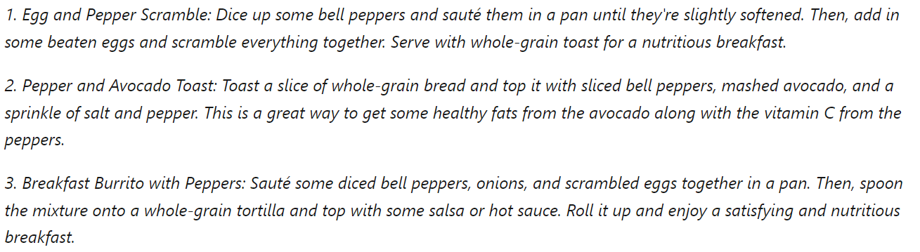
What is Generative AI ?
Generative AI describes a category of capabilities within AI that create original content
Generative AI applications take in natural language input, and return appropriate responses in a variety of formats such as natural language, images, or code
1. Natural Language Generation:
To generate a natural language response, you might submit a request such as "Give me three ideas for a healthy breakfast including peppers.“
A generative AI application might respond to such a request like this:
OK, here are three healthy breakfasts that include peppers:

Slide 34
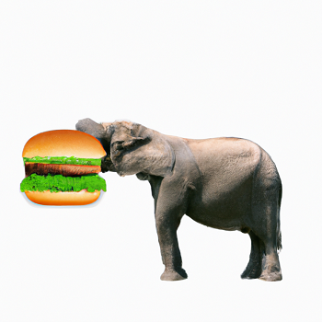
2. Image Generation:
Some generative AI applications can interpret a natural language request and generate an appropriate image
For example, you might submit a request like "Create an image of an elephant eating a burger".
A generative AI application could then return an original new image based on the description you provided, like this:

Slide 35
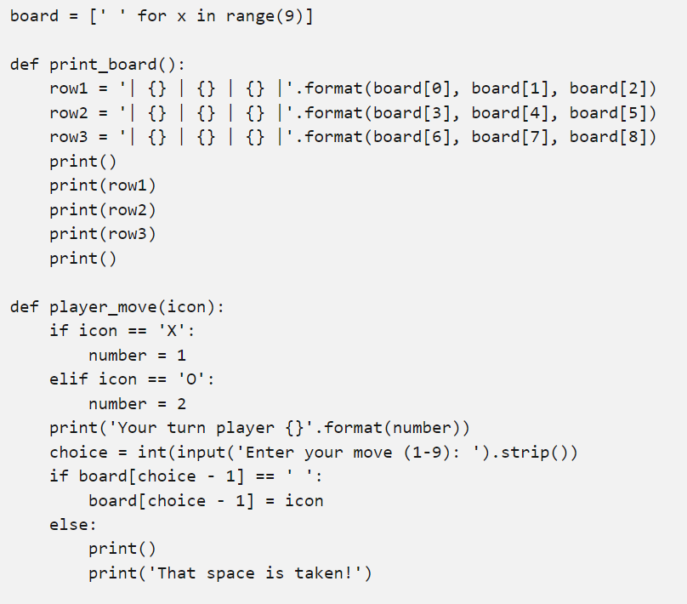
3. Code Generation
Some generative AI applications are designed to help software developers write code
For example, you could submit a request like "Show me how to code a game of tic-tac-toe with Python" and generate the following response:
Sure, here's some basic code for a Tic-Tac-Toe game in Python:

Slide 36

Microsoft Bing AI
Bing AI is like having a research assistant, personal planner, and creative partner at your side whenever you search the web
When you ask complex questions, Bing gives you detailed replies
Bing AI looks at search results across the web to offer you a summarized answer and links to its sources
Bing Chat is built into Microsoft Edge, so it's a more integrated, tailored way of searching for answers
ChatGPT, though a more isolated app experience-offers more powerful integrations and plugins, and lets you easily collaborate on conversations
Bing Image Creator helps you generate AI images with DALL-E right from the sidebar in Microsoft Edge. Given a text prompt, our AI will generate a set of images matching that prompt.

Slide 37
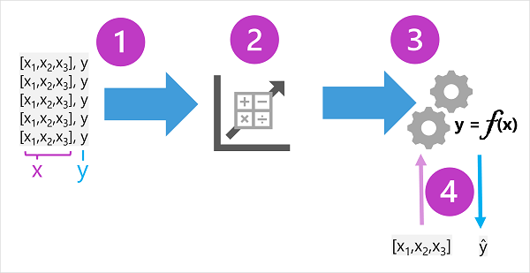
Machine Learning
Traditional Programming: Based on Rules Machine Learning: Learning from Examples
Machine learning is in many ways the intersection of two disciplines - data science and software engineering
The goal of machine learning is to use data to create a predictive model that can be incorporated into a software application or service
The fundamental idea of machine learning is to use data from past observations to predict unknown outcomes or values
Machine learning as a function:
A machine learning model is a software application that encapsulates a function to calculate an output value based on one or more input values
The process of defining that function is known as training
After the function has been defined, you can use it to predict new values in a process called inferencing

Slide 38
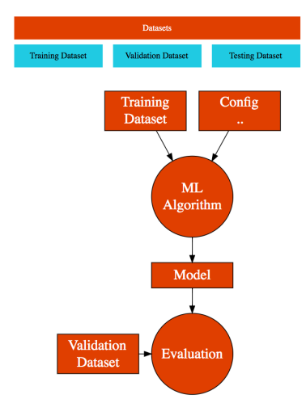
Machine Learning Terminology
Process:
Training: The process of creating a model
Evaluation: Is the model working ?
Inference: Using the model to do predictions in production
Dataset:
Features: Inputs to the model
Label: Output/Prediction from the model
Training Dataset: Dataset used to create a model
Validation Dataset: Dataset used to validate the model
Testing Dataset: Dataset used to do final testing before deployment

Slide 39
Creating ML Models - Features and Labels
Give inputs to a model with training data set(Training)
ML model is built
Evaluate the model with validation dataset(Evaluation)
Test the model with testing dataset before deployment(Testing)
Model returns the prediction (Inference)
Examples:
House Price Prediction Model
Label: price
Features: Area: Total area of house (m^2)
Rooms: No. of rooms
Bedrooms: No. of bedrooms
Furniture: Is it furnished ?
Floor: Which floor ?
Age: How many years ?
Balcony: has balcony or not
Garden: has garden or not
Price: Price of the house

Slide 40
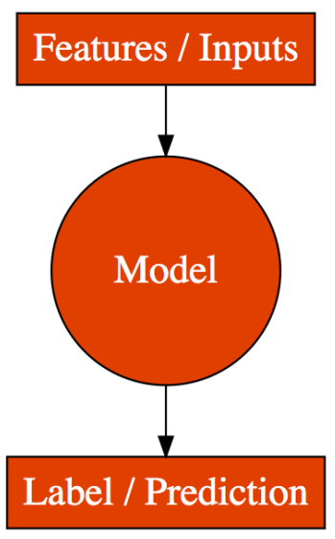
Used Car Price Prediction Model
Label: price
Features: manufacturer, year, model, age, condition, cylinders, location
Spam Email Classification Model
Label: isSpam
Features: sender, subject, content
Grant a Loan Model
Label: shouldWeGrantALoan
Features: doesOwnCar, doesOwnRealEstate, creditScore, isMarried,
doesHaveChildren, totalIncome, totalCredit

Slide 41
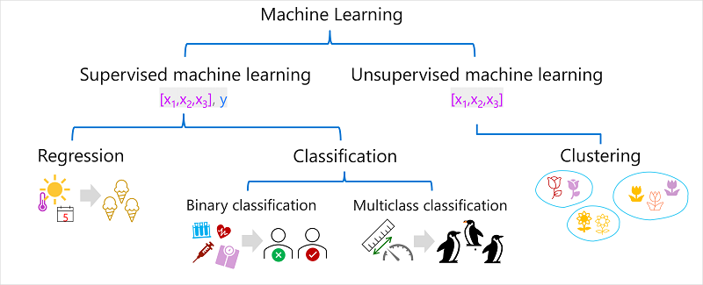
Types of Machine Learning

Slide 42
Supervised Machine Learning:
Supervised machine learning is used to train models by determining a relationship between the features and labels in past observations, so that unknown labels can be predicted for features in future cases
Regression:
Regression is a form of supervised machine learning in which the label predicted by the model is a numeric value
For example, number of ice creams sold on a given day based on the temperature, rainfall, and windspeed, etc.
Classification:
Classification is a form of supervised machine learning in which the label represents a categorization, or class
Binary classification: binary classification models predict one of two mutually exclusive outcomes
For example, whether a patient is at risk for diabetes based on clinical metrics like weight, age, blood glucose level, and so on
the model predicts a binary true/false or positive/negative prediction for a single possible class
Multiclass classification: extends binary classification to predict a label that represents one of multiple possible classes.
For example, the genre of a movie (comedy, horror, romance, adventure, or science fiction) based on its cast, director, and budget

Slide 43
Unsupervised Machine Learning:
Unsupervised machine learning involves training models using data that consists only of feature values without any known labels
Unsupervised machine learning algorithms determine relationships between the features of the observations in the training data
Clustering:
The most common form of unsupervised machine learning is clustering
A clustering algorithm identifies similarities between observations based on their features, and groups them into discrete clusters
For example, group similar flowers based on their size, number of leaves, and number of petals
In clustering, there's no previously known cluster label and the algorithm groups the data observations based purely on similarity of features

Slide 44

Azure Machine Learning
Azure Machine Learning is a cloud service for training, deploying, and managing machine learning models
Azure Machine Learning workspace
The primary resource required for Azure Machine Learning is an Azure Machine Learning workspace, which you can provision in an Azure subscription
Workspaces are places to collaborate with colleagues to create machine learning artifacts and group related work
For example, experiments, jobs, datasets, models, components, and inference endpoints
Azure Machine Learning studio
After you've provisioned a workspace, you can use it in Azure Machine Learning studio
A browser-based portal for managing your machine learning resources and jobs
Automated Machine Learning, Azure Machine Learning Designer

Slide 45
Challenges in building AI solutions
Challenge or Risk | Example
Bias can affect results | A loan-approval model discriminates by gender due to bias in the data with which it was trained
Errors may cause harm | An autonomous vehicle experiences a system failure and causes a collision
Data could be exposed | A medical diagnostic bot is trained using sensitive patient data, which is stored insecurely
Solutions may not work for everyone | A home automation assistant provides no audio output for visually impaired users
Users must trust a complex system | An AI-based financial tool makes investment recommendations - what are they based on ?
Who's liable for AI-driven decisions ? | An innocent person is convicted of a crime based on evidence from facial recognition – who's responsible ?

Slide 46
Responsible AI principles
At Microsoft, AI software development is guided by a set of six principles, designed to ensure that AI applications provide amazing solutions to difficult problems without any unintended negative consequences
1. Fairness
AI systems should treat all people fairly
For example, suppose you create a machine learning model to support a loan approval application for a bank. The model should predict whether the loan should be approved or denied without bias
Azure Machine Learning includes the capability to interpret models and quantify the extent to which each feature of the data influences the model's prediction
This capability helps data scientists and developers identify and mitigate bias in the model

Slide 47
2. Reliability and Safety
AI systems should perform reliably and safely
For example, consider an AI-based software system for an autonomous vehicle or a machine learning model that diagnoses patient symptoms and recommends prescriptions
Unreliability in these kinds of systems can result in substantial risk to human life
AI-based software application development must be subjected to rigorous testing and deployment management processes to ensure that they work as expected before release
3. Privacy and Security
AI systems should be secure and respect privacy
The machine learning models on which AI systems are based rely on large volumes of data, which may contain personal details that must be kept private
Even after the models are trained and the system is in production, privacy and security need to be considered

Slide 48
4. Inclusiveness
AI systems should empower everyone and engage people
AI should bring benefits to all parts of society, regardless of physical ability, gender, sexual orientation, ethnicity, or other factors
5. Transparency
AI systems should be understandable
Users should be made fully aware of the purpose of the system, how it works, and what limitations may be expected
6. Accountability
People should be accountable for AI systems
Designers and developers of AI-based solutions should work within a framework of governance and organizational principles that ensure the solution meets ethical and legal standards that are clearly defined

Slide 49
Useful Links
AI Introduction: https://learn.microsoft.com/en-us/training/modules/get-started-ai-fundamentals/1-introduction
Machine Learning: https://learn.microsoft.com/en-us/training/modules/fundamentals-machine-learning/2-what-is-machine-learning
Azure AI services: https://learn.microsoft.com/en-us/training/modules/fundamentals-azure-ai-services/2-what-are-ai-services
Computer Vision: https://learn.microsoft.com/en-us/training/paths/explore-computer-vision-microsoft-azure/
Natural Language Processing: https://learn.microsoft.com/en-us/training/paths/explore-natural-language-processing/
Document Intelligence: https://learn.microsoft.com/en-us/training/paths/document-intelligence-knowledge-mining/
Generative AI: https://learn.microsoft.com/en-us/training/paths/introduction-generative-ai/
Create your own bot: https://microsoftlearning.github.io/mslearn-ai-fundamentals/Instructions/Labs/07-question-answering.html
Using CLU to create Home Automation System: https://microsoftlearning.github.io/mslearn-ai-fundamentals/Instructions/Labs/08-conversational-language-understanding.html

Slide 50
AI-900
https://learn.microsoft.com/en-us/credentials/certifications/exams/ai-900/
Different Types of Multiple-Choice Questions
Type 1 : Single Answer - 2/3/4 options and 1 right answer
Type 2 : Multiple Answer - 5 (or more) options and 2 (or more) right answers
No penalty for wrong answers
40 questions and 60 minutes
Result will be shown immediately after exam completion
Email with detailed scores will be sent a couple of days later

Slide 51
Thank You.
Happy Learning.

